Slide 1


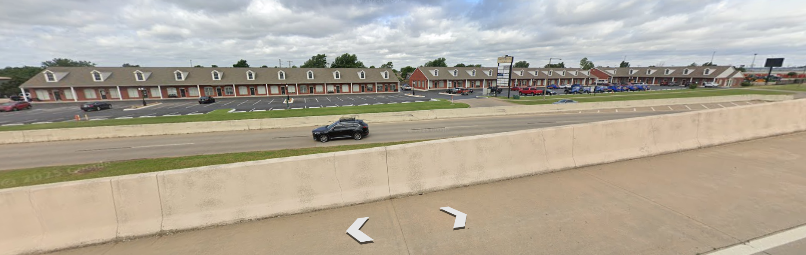
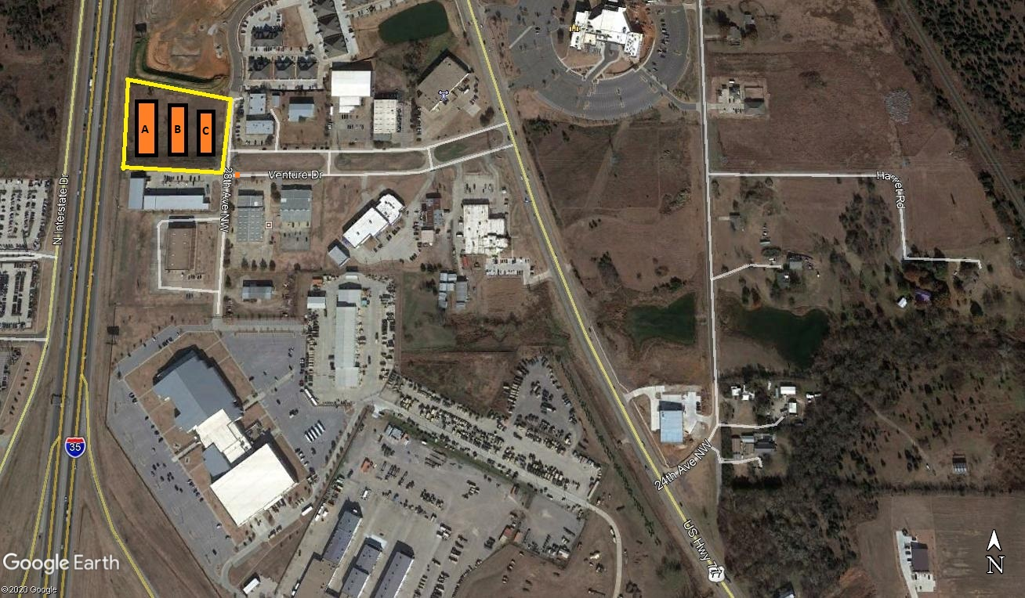
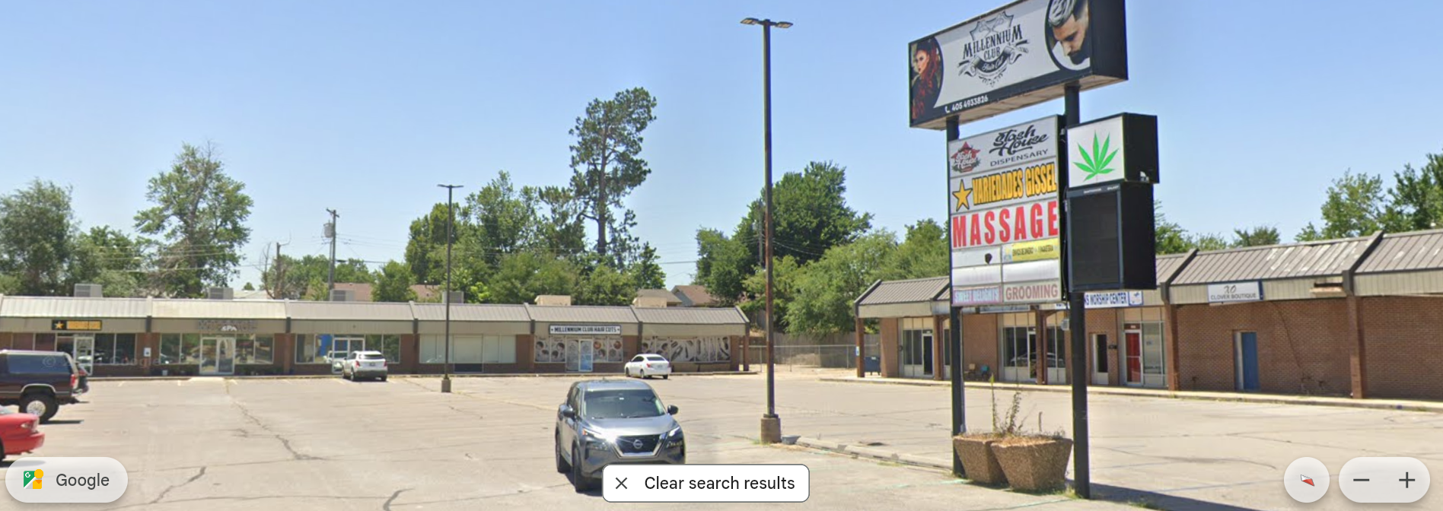

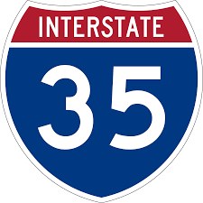



For Lease
1901-1915 N. Moore Ave.
Moore, OK 73160
N
Site
2
8
t
h
a
v
e
Venture Dr.
For Sale
OU
Book
Dep.
PROPERTY INFORMATION:
PROPERTY DESCRIPTION
Tecumseh Rd.
Address:
City/State/Zip
Sales Price:
NOI:
CAP Rate:
Building Size SF
Price $PSF:
Total Units:
Unit Dimensions:
Year Built:
Lot Size:
Lease Type
Occupancy:
1901–1915 N. Moore Ave.
Moore, OK 73160
$3,400,00
$282,910
8.32%
36,034
$94.35
30 Units – 17 Tenants
20’ x 60’ +/-
1998
4.32 ac.
Full NNN
82% (3 vacant units)
North Moore Plaza is a three (3) building mixed use complex consisting of office and retail use. It fronts on the west side of I-35 service road and is accessible from both the north and south service road traffic. The are a total of 30 units (some combined) featuring a total of 17 individual tenants. The roofs are pitched with asphalt shingles and there are 174 parking spaces with a ratio of 4.8 spaces/1000 sf. The tenant base is stable and established with an excellent mix of office and retailers. There are (3) vacant units totaling 6,447 sf for value upside to the NOI. The vacant units are all 2nd gen and will require little to zero build-out. The going in CAP rate is 8.32% based on current in place NOI. The property is in excellent condition and well priced. A great versatile asset to add to your portfolio. Parking Lot re-surfaced and striped 3 years ago approx.
LOCATION
Fronting on I-35 (west side), just south of
DEMOGRAPHICS
1 Mile 3 Miles 5 Miles
5,500 30,200 71,600
15,300 80,200 184,400
$59,000 $58,200 $68,500
Total Households
Total Population
Average HH Income
CONTACT:
Scott Heiple, CCIM | Owner – Managing Broker
HCB Commercial Real Estate Co., LLC
P.O. Box 639 Norman, Oklahoma 73070
405.473.7653 (mobile)
405.447.7124 (fax)
scott.heiple@hcbcommercial.com (email)
www.hcbcommercial.com (web)

Slide 2

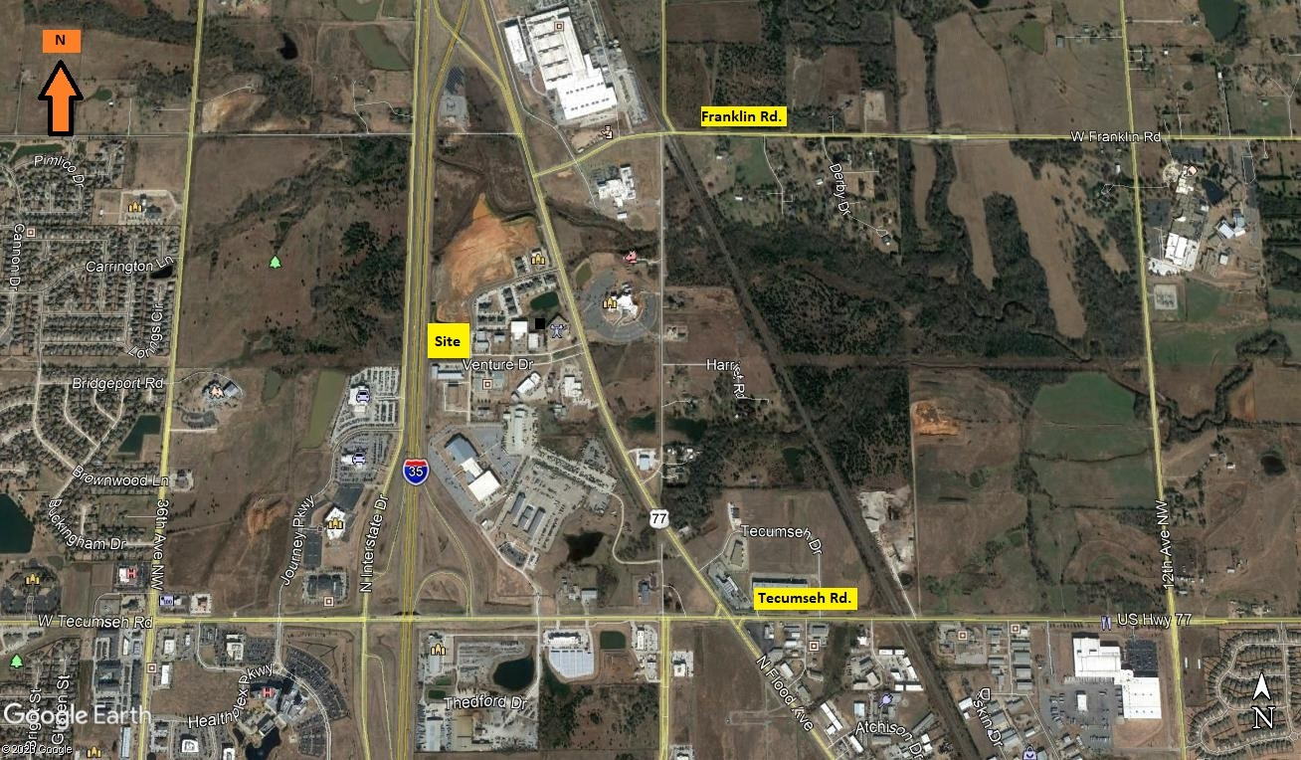
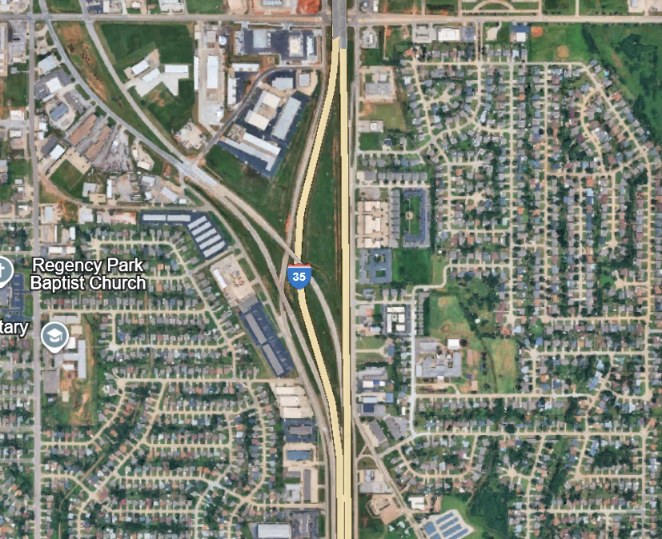
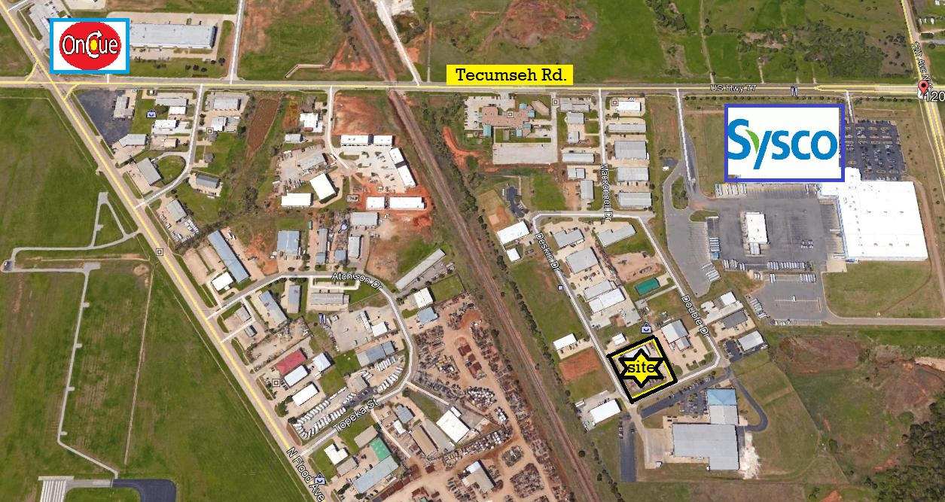
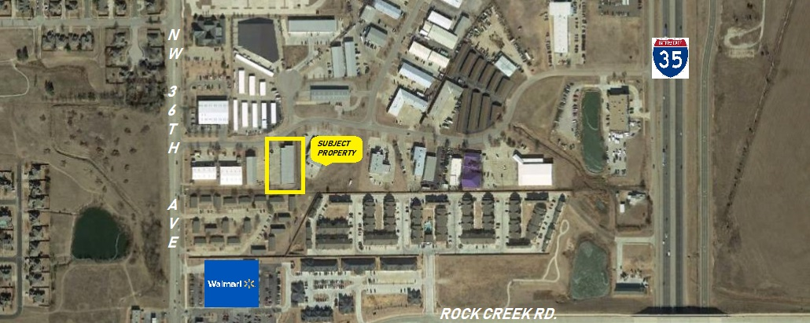
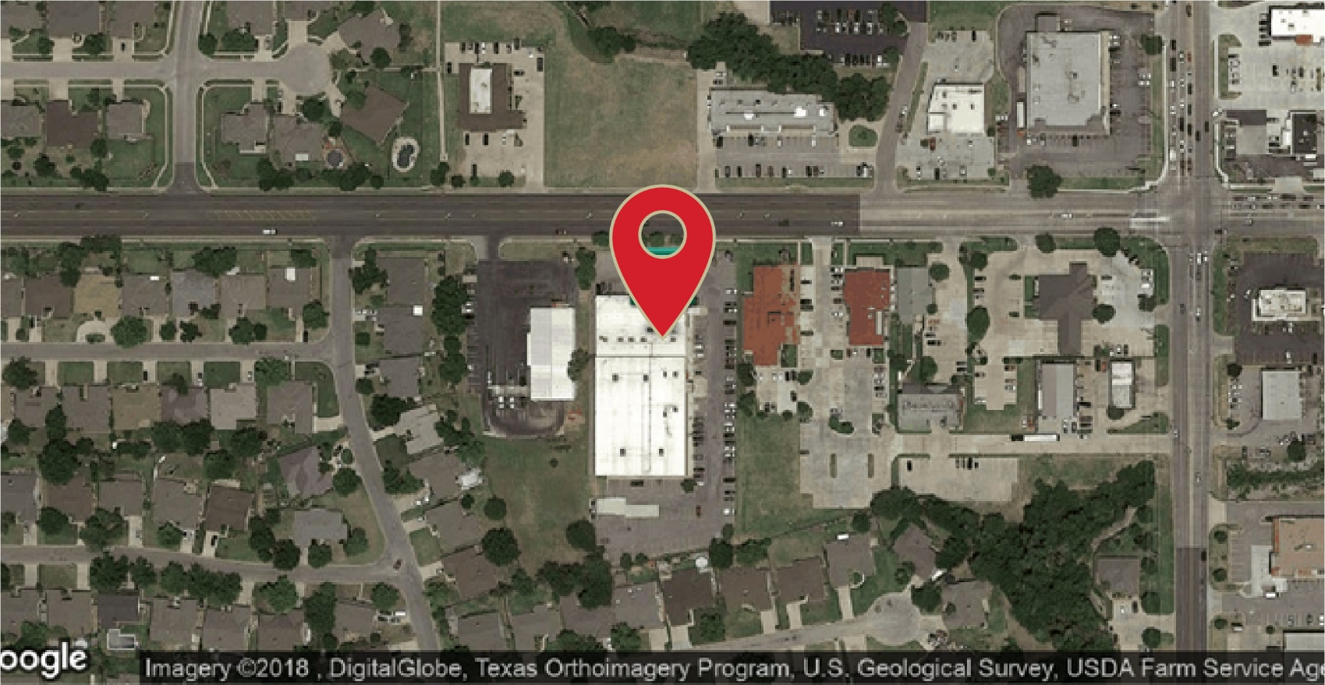
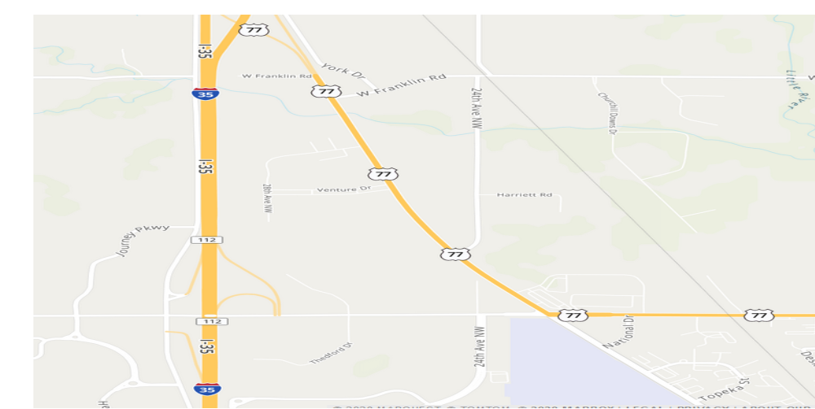
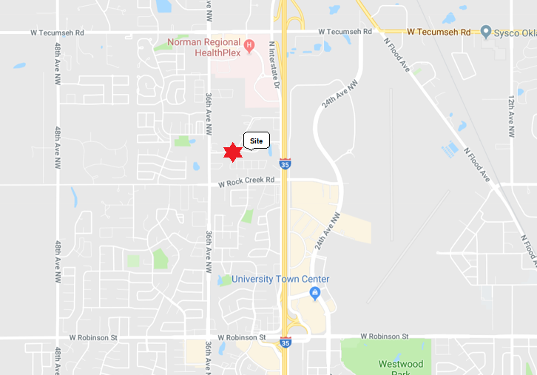
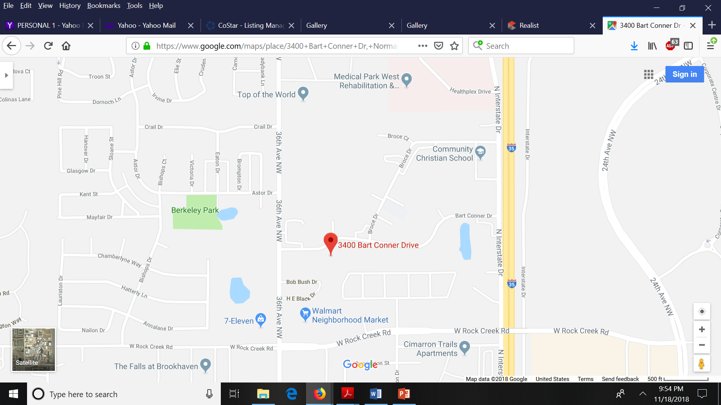
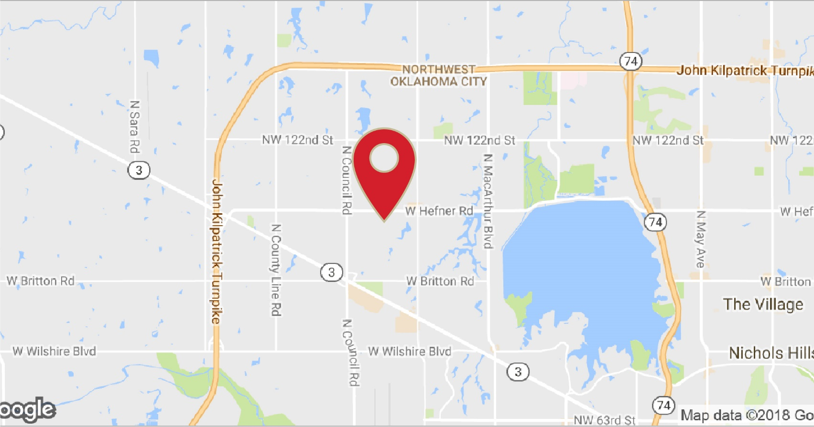


North Moore Plaza
Aerial Map
NW 27th St.
Site
Shields Blvd.
R
O
C
K
W
E
L
L
N. Moore Ave..
Peach Tree Center
Tecumseh Rd.
N
Site
Franklin Rd.
site
Site
Site
Site
NW 23rd
Venture Dr.
28th Ave. NW
OU
Book
Tecumseh Rd.
CONTACT:
Scott Heiple, CCIM | Owner – Managing Broker
HCB Commercial Real Estate Co., LLC
P.O. Box 639 Norman, Oklahoma 73070
405.473.7653 (mobile)
405.447.7124 (fax)
scott.heiple@hcbcommercial.com (email)
www.hcbcommercial.com (web)

Slide 3
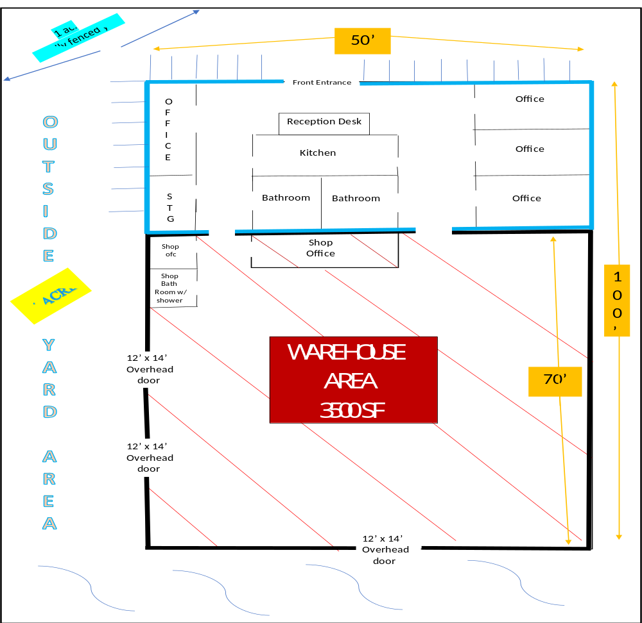
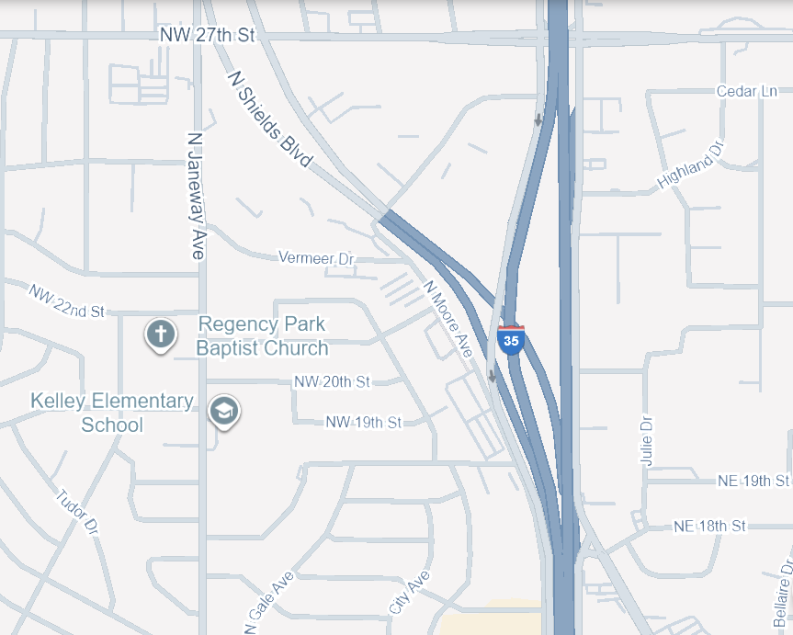
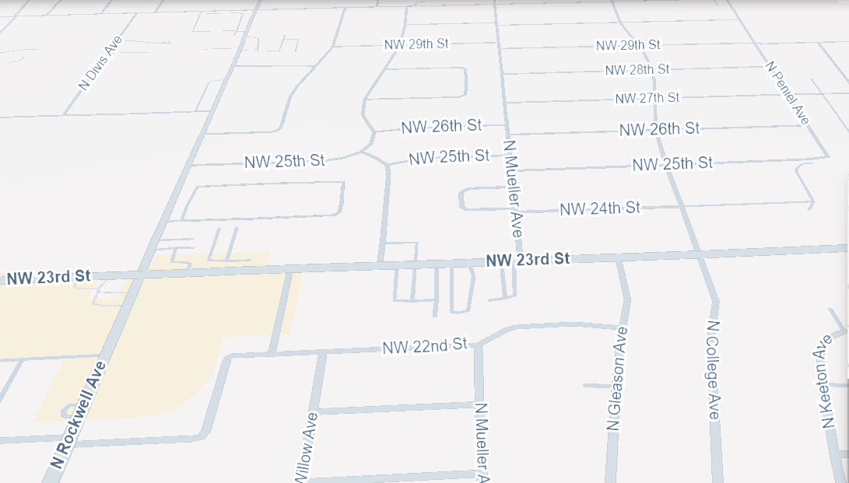
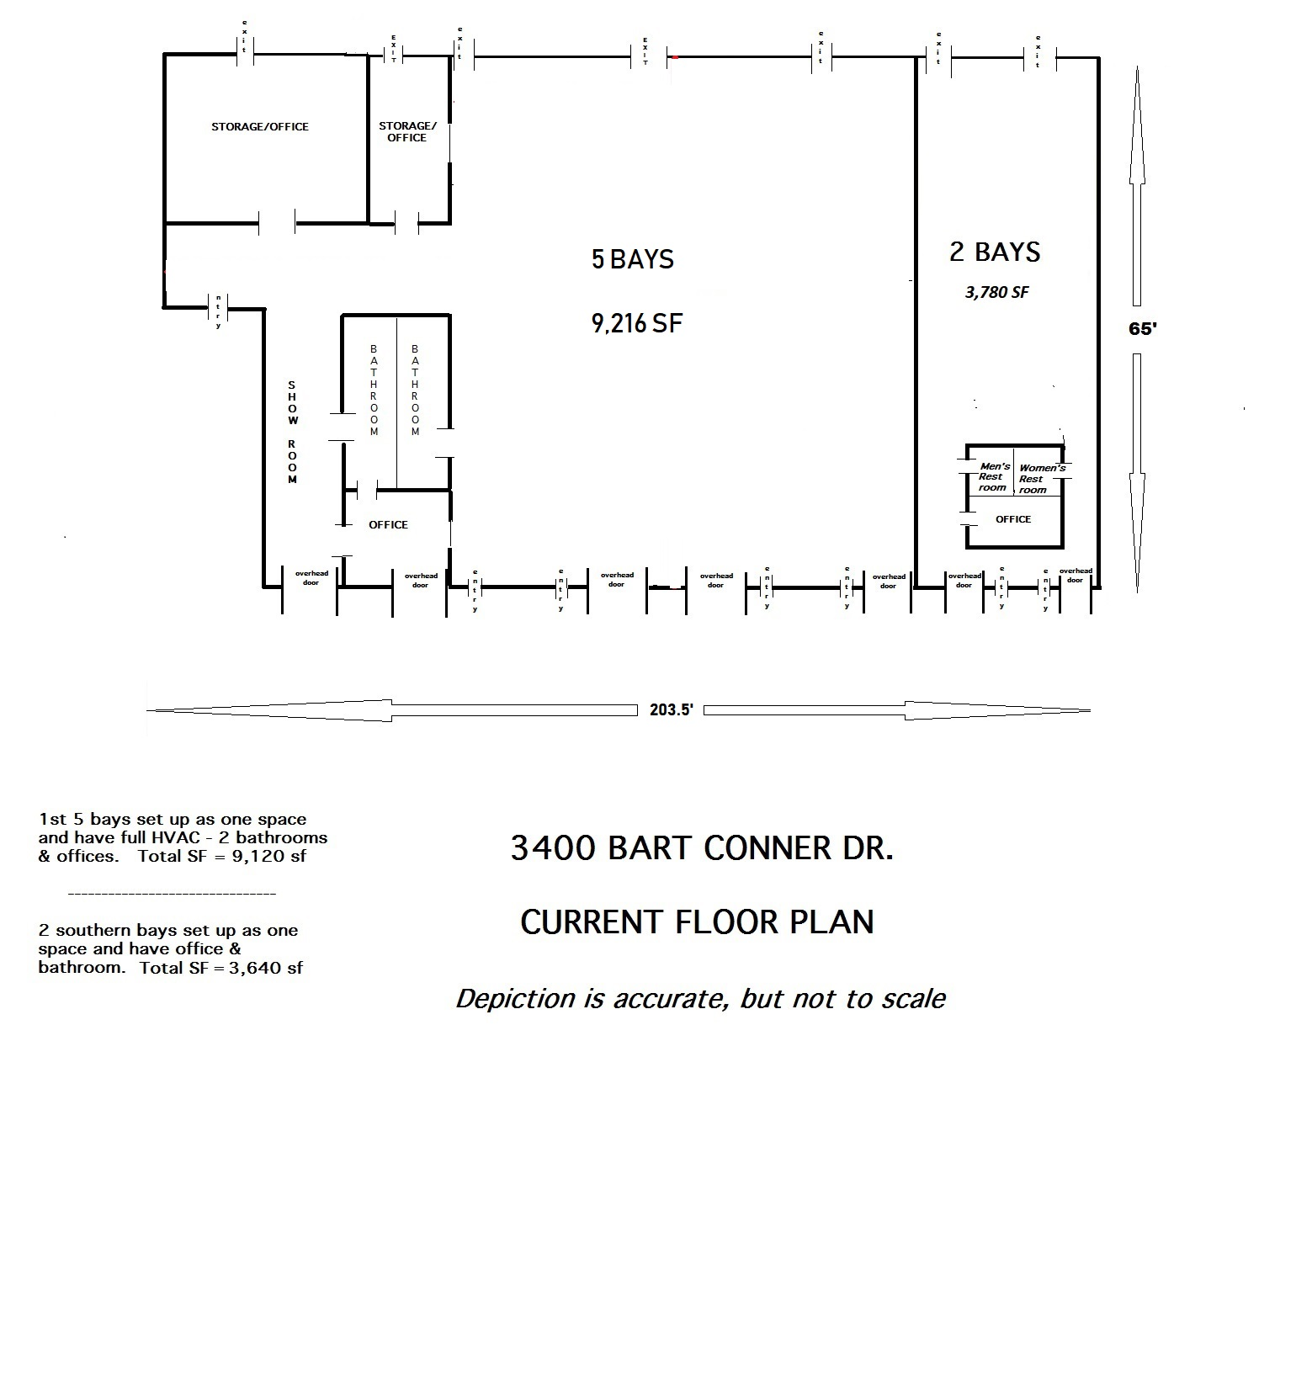

North Moore Plaza
Street Map Location
Site
N
Victory Church
AVAILABLE
Venture Dr.
LEASED
28th Ave. NW
For sale
or Lease
Bldg. C
Warehouse
Warehouse
3500 sf
site
Site
70’
9,216 SF
3500 s
70’ x 50’f
3,780 SF
CONTACT:
Scott Heiple, CCIM | Owner – Managing Broker
HCB Commercial Real Estate Co., LLC
P.O. Box 639, Norman Oklahoma 73070
405.473.7653 (mbl)
405.447.7124 (fax)
scott.heiple@hcbcommercial.com (email)
www.hcbcommercial.com (web)

